Slide 1
Training Racing Cars
Amina Tabassum
Siddhartha Dhar Choudhury

Slide 2
Problem Statement
  Training racing cars using Deep Q- Learning and REINFORCE to reach goal state

Slide 3
Environment
Observation Space
  Discrete
  Road, Grass and Soil
Action Space
    Discrete
    Do nothing, left, right, accelerate, Brake

Slide 4
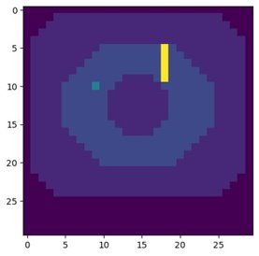
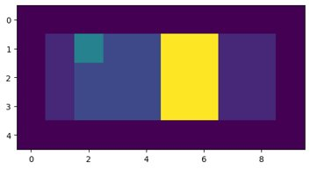
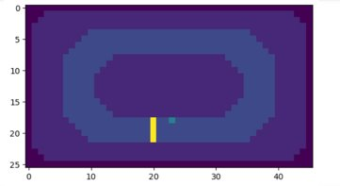
Tracks

Slide 5
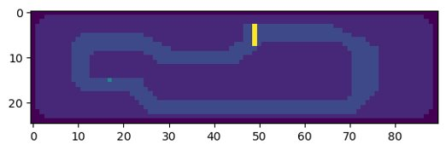
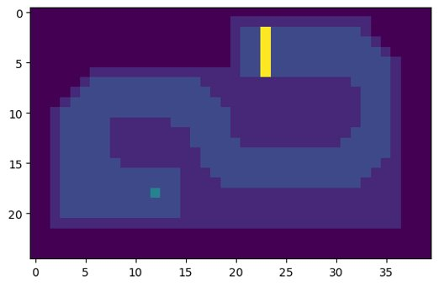
Tracks

Slide 6


Algorithms
DQN
REINFORCE

Slide 7
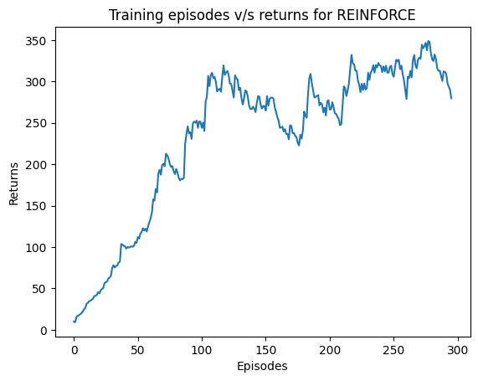
Results

Slide 8
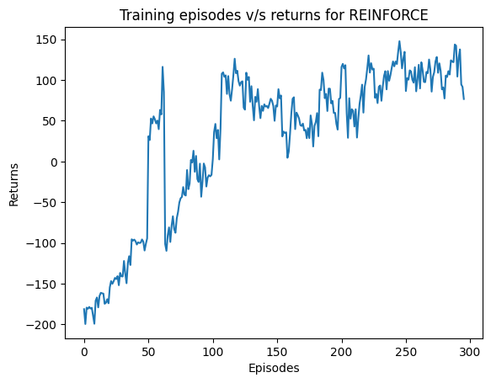
Results

Slide 9
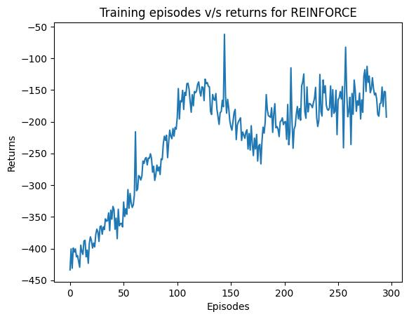
Results

Slide 10
Future Work
Implement DQN and REINFORCE on following tracks

Slide 11
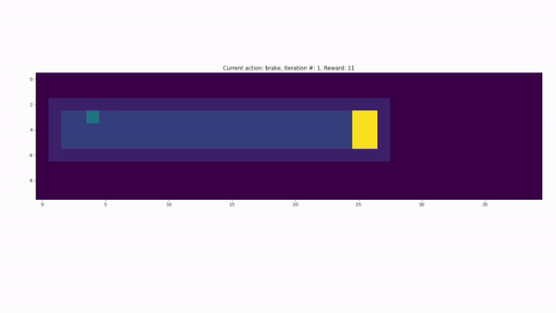
Demo Video
Trained on a smaller straight line race track and tested on longer race track

Slide 12
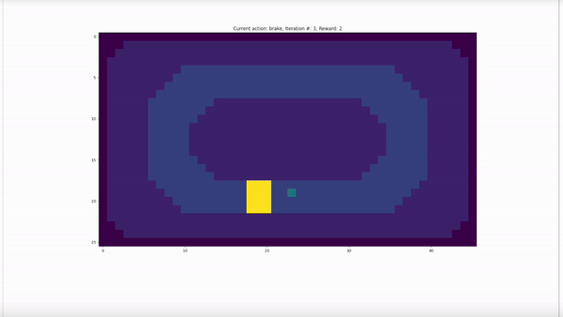
Demo Video
Ellipse results after 50 episodes

Slide 13

Demo Video
Ellipse results after 130 episodes

